Slide 1
HPCC (High-Performance Computing Cluster): A type of computing system designed to perform complex calculations and process large datasets efficiently.
How to connect to HPCC:
https://docs.icer.msu.edu/Connect_to_HPCC_System/

Slide 2

Connecting to HPCC
e.g., using a local Mac to connect to HPCC:
Step 1: open the terminal on your Mac.
Step 2: In your terminal, type:
ssh -XY <username>@hpcc.msu.edu
Step 3: Enter your password.
Step 4: Choose a development node by typing:
ssh <node_name>
Choose one node from these as <node_name>

Slide 3
Advanced:
How to use Conda on HPCC:
https://docs.icer.msu.edu/Using_conda/
How to use R on HPCC:
https://docs.icer.msu.edu/R_workshop_tutorial/

Slide 4
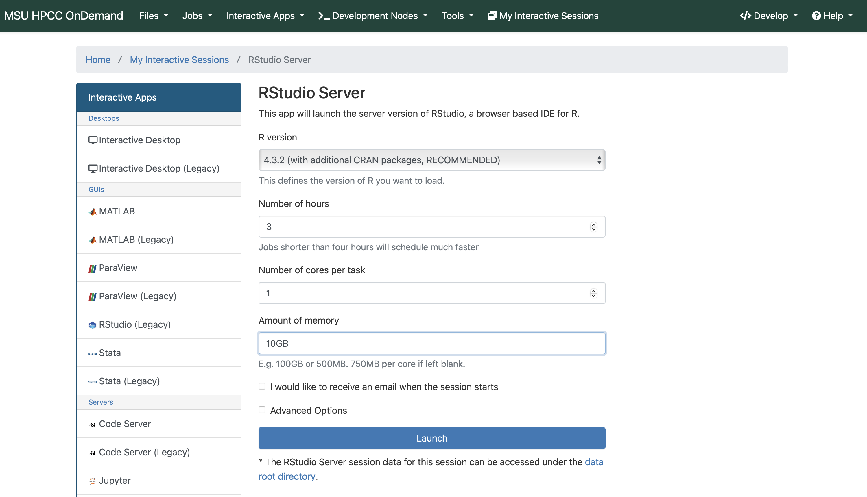
Launch R studio via HPCC OnDemand
https://ondemand.hpcc.msu.edu/
For this tutorial, we suggest: Number of hours: 3 Number of cores per task: 1 Amount of memory: 10 GB

